Slide 1
bank laon analysis
File created on: 29-07-2024 04:13:48

Slide 2
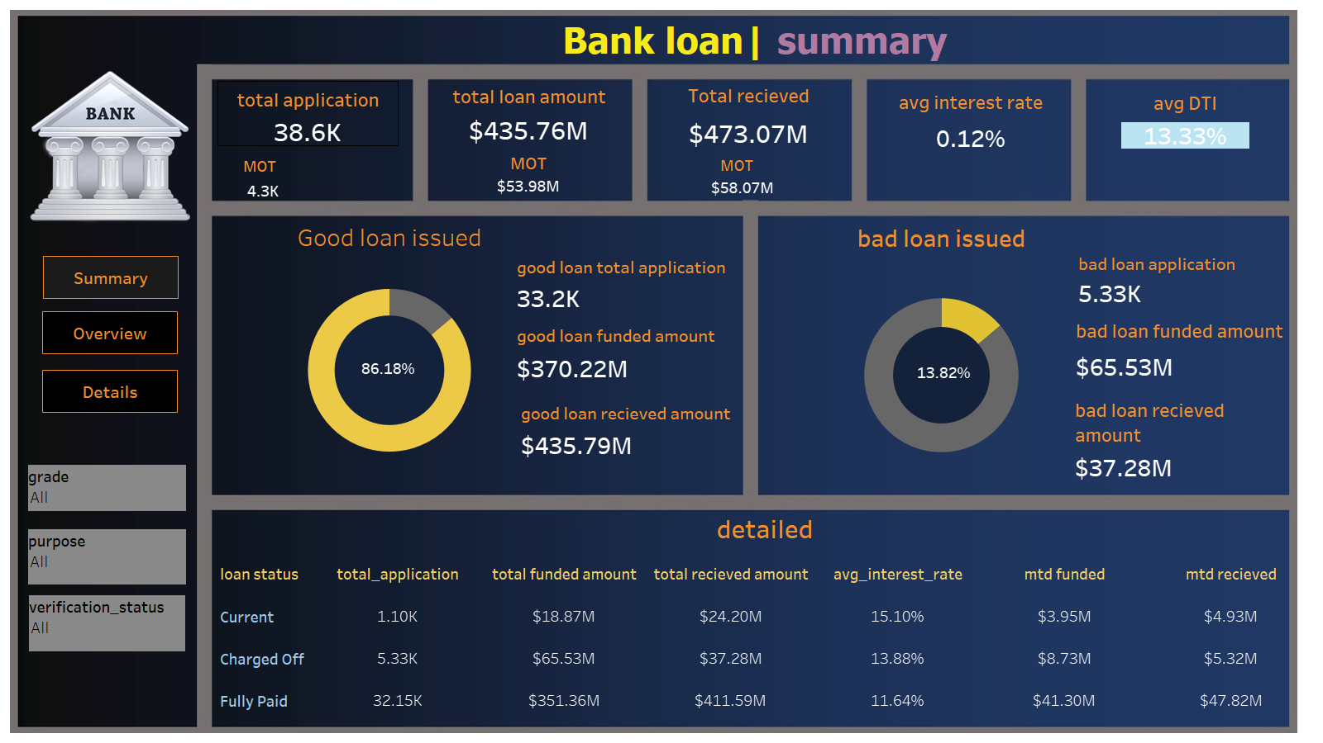

Slide 3
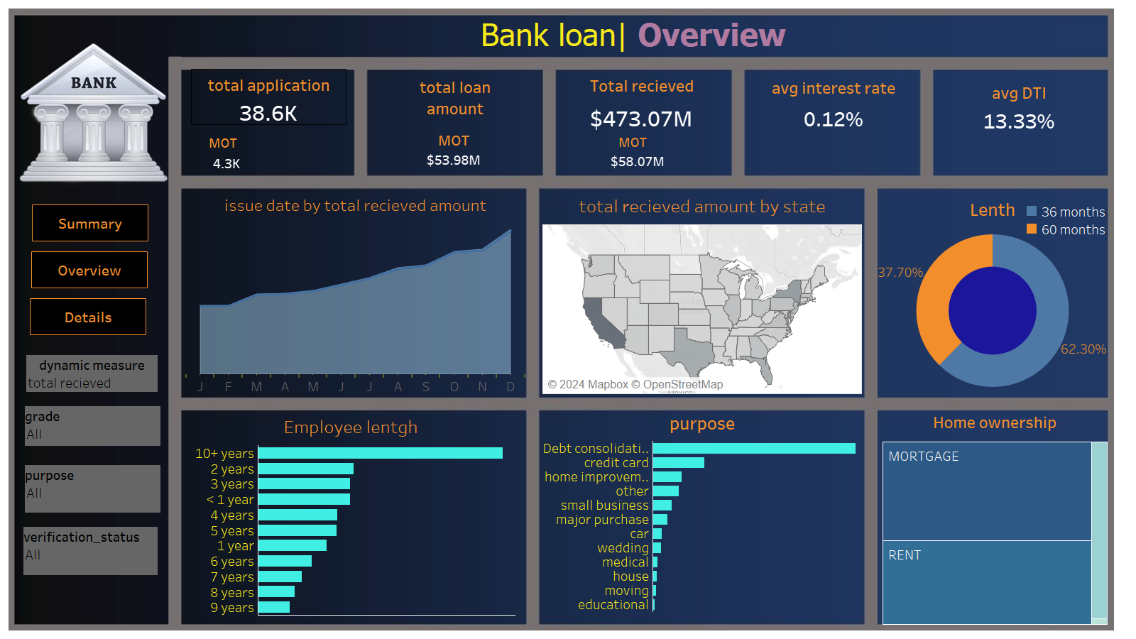

Slide 4
